Slide 1

Machine Learning: Modeling suicide rates in Mexico
Final Project
Marcela Vázquez
Víctor González
Felipe Murillo
TEC Data Bootcamp | September 5, 2020

Slide 2

Modeling overview
x
datapoints
year
gender
age group
population of age group
GDP per capita
unemployment rate
divorce rate
adult/childhood obesity
alcohol consumption
net migration rate
Hyperparameter-tuning cross validation (CV) on highest-scoring model
Linear regression
Random
forest
Polynomial features + ridge regression
Gradient tree boosting regression
Support vector machines regression
Convert categorical data into indicator variables
Random Search CV
Grid Search CV
Optimized Model
Training and testing sets
StandardScaler
Fit
Model
MinMaxScaler
Predict
y
Split
Scale
target = suicide rate
# of suicides (per 100,000 ppl)
Dataset
Machine Learning
Hypothesis: there exists a function $f\left(x\right)$ that best describes suicide rates (y)

Slide 3
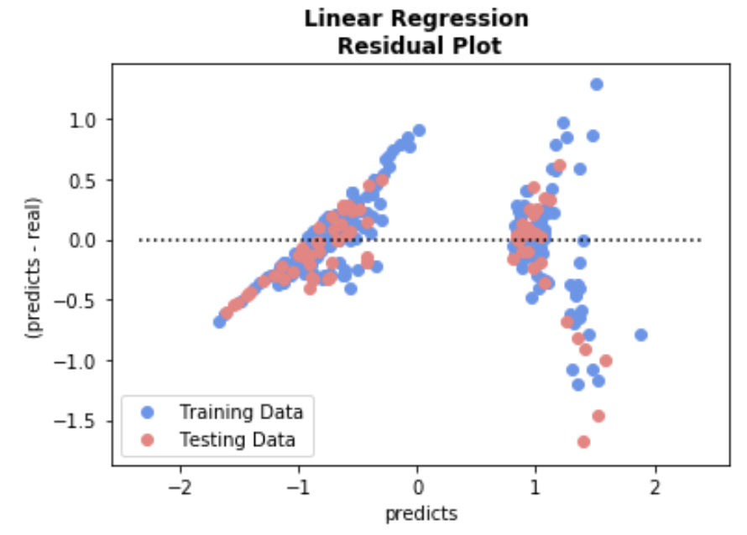
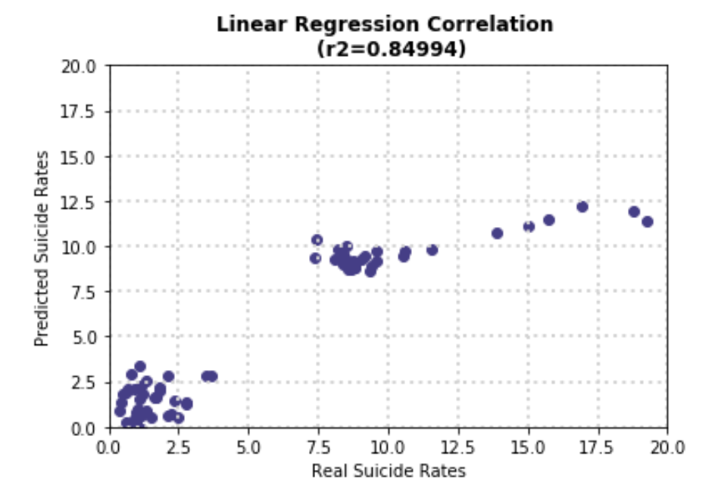
Model results | Linear Regression
In a good model, predicted and real suicide rates would be linearly proportional
(i.e., 1-to-1 relationship)
In this simple model, both MinMaxScaler and StandardScaler yield the same results

Slide 4
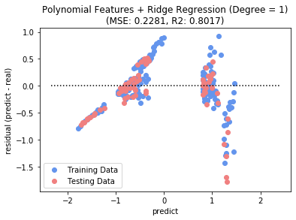
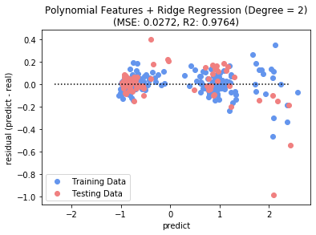
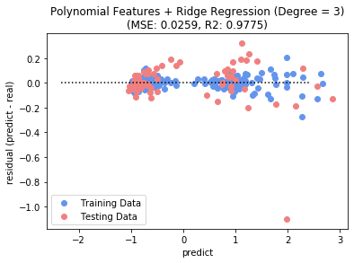
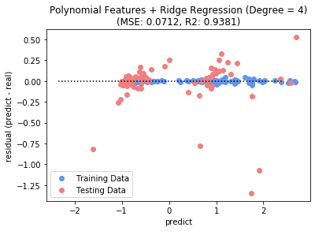
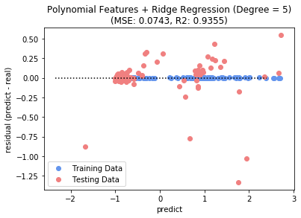
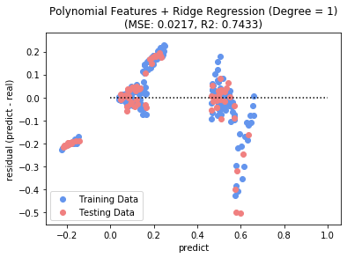
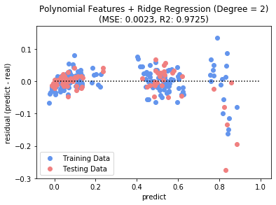
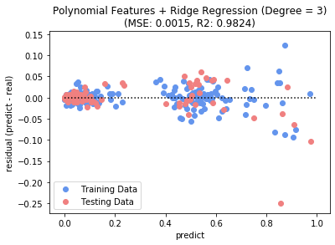
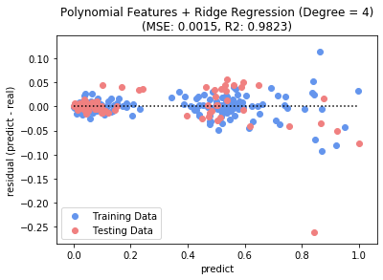
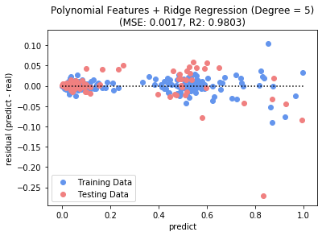
Model Results | Polynomial Features + Ridge Regression (1/2)
StandardScaler
n = 1
n = 2
n = 3
n = 4
n = 5
MinMaxScaler
Iterate model to find an nth degree polynomial (a_{n}x^{n} +…+ a₂x² + a₁x + a_{o}) with best R² score → n = 3 works best!

Slide 5
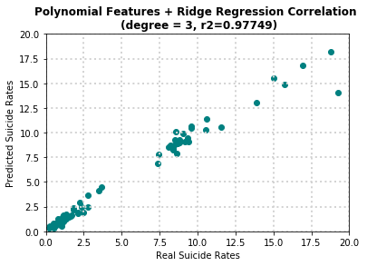
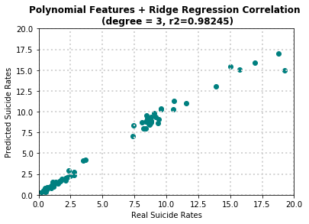
Model Results | Polynomial Features + Ridge Regression (2/2)
StandardScaler
MinMaxScaler
This model is now diagonal, which means predicted data is looking more like the real test data.
Scaling data using the MinMaxScaler results in better performance.

Slide 6
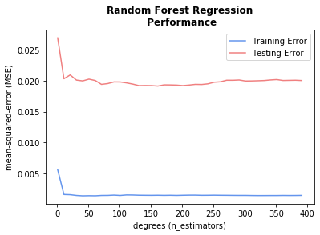
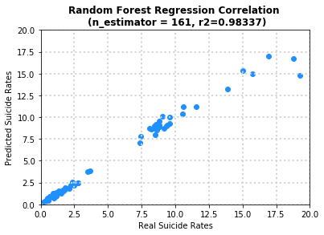
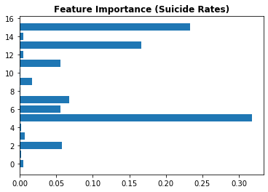
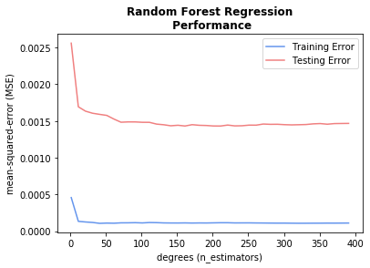
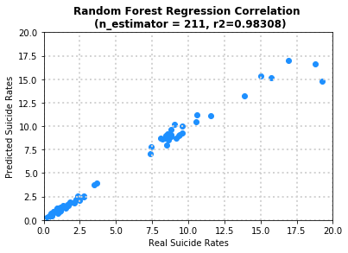
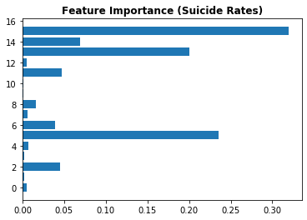
Model Results | Random Forest Regression
StandardScaler
This type of regression provides insight into which features are relatively important in this model.
Age 75+ makes sense because it reflects the grp with highest # of suicides, but children and obesity?!
Obesity rates are derived from two different datasets: childhood obesity (applicable only to age grp 5-14 yrs) and adult obesity (ages +18), applicable to all other age grps. There’s only 2 values for every given year.
age 75+ yrs
age 5-14 yrs
obesity
MinMaxScaler

Slide 7
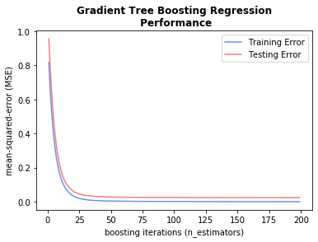
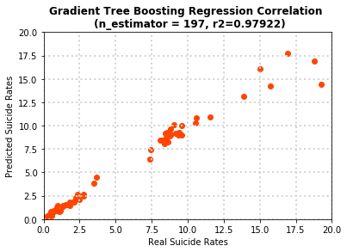
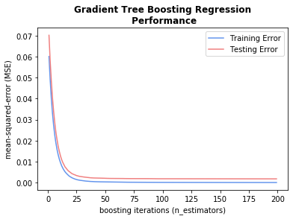

Model Results | Gradient Tree Boosting
StandardScaler
Again, similar results are observed using both scaling options. Both are below the performance of the random tree regression model
MinMaxdScaler

Slide 8
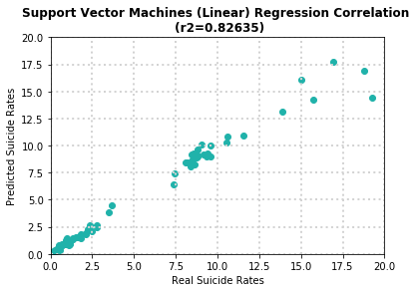
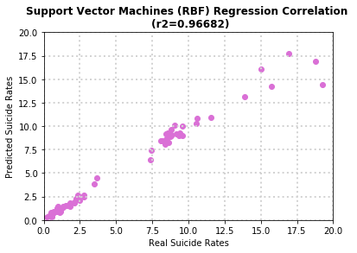
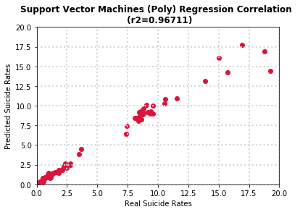



Model Results | Support Vector Machines
StandardScaler
Using a StandardScaler + polynomial flavor of SVM regression yields the best results for this type of model
Linear
Radial-basis function
Polynomial
MinMaxScaler

Slide 9
Optimizing the model
Coefficient of Determination (R² scores)
Regression Model | Standard Scaler | MinMaxScaler | SS Learning Time
Linear | 0.850 | 0.850 | 0.107s
Polynomial features + Ridge (n=3) | 0.978 | 0.982 | 0.009s
Random Forest
Base | 0.98337 | 0.98308 | 0.266s
+ Randomized Search CV | 0.98465 (Base+0.1%) | - | 52.521s
+ Grid Search CV | 0.98703 (Base+0.4%) | - | 313.598s
Gradient Tree Boosting | 0.979 | 0.979 | 0.111s
Support Vector Machines (polynomial) | 0.967 | 0.941 | 0.031s
Model with tuned up parameters
RandomForestRegressor:
'bootstrap': True,
'max_depth': 10,
'max_features': 'auto', 'min_samples_leaf': 1, 'min_samples_split': 4, 'n_estimators': 160
High-performing model selected for hyperparameter tuning using Randomized Search Cross Validation (CV)

Slide 10
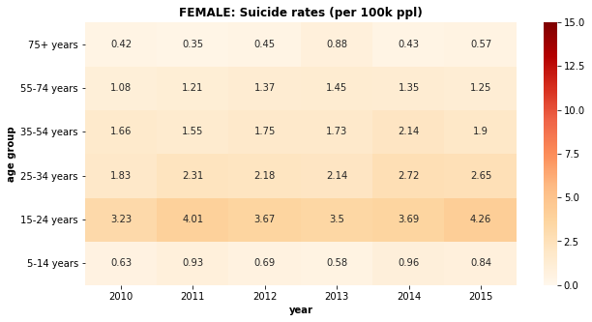
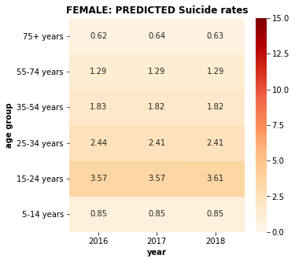
Predicting female suicide rates
REAL suicide rates
(per 100,000 ppl)
PREDICTED suicide rates
(per 100,000 ppl)
Model inputs:
GDP per capita, unemployment, obesity: use real data
Migration, alcohol: real data (which stays constant from 2015)
Divorce: use real 2016 data and leave constant
Population: use “real” INEGI projections

Slide 11
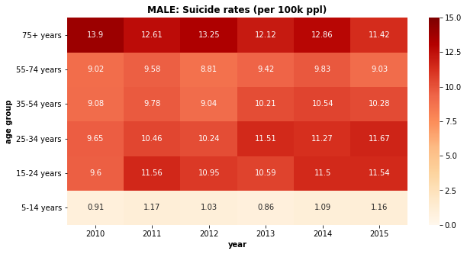
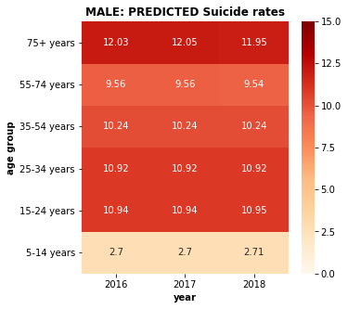
Predicting male suicide rates
REAL suicide rates
(per 100,000 ppl)
PREDICTED suicide rates
(per 100,000 ppl)
For population data, INEGI dataset was used rather than the WHO dataset used to generate the model. There’s a +400K difference in population reported in this age group for males (+250K for females). Explains the sudden jump 2015 to 2016.

Slide 12
Further considerations
Explore different indicators impacting suicide rates
Get subject matter experts involved (i.e., psychologists, epidemiologists, etc.)
Get data scientist involvement for additional regressions to run
Try different scalers on different models
Hyper-tune parameters on other high-performing models, Polynomial + Ridge and Gradient Tree Boosting regressors
Where else to apply machine learning to this topic:
Identifying individuals who may have suicidal tendencies: Use classifier model on social media content to determine if triggering words are being used
Use knowledge to target ”get-help” advertisements to local programs and specialized treatment

Slide 13
Indicator description/sources
datapoint | description | sources
year | 1987 - 2015 | Kaggle https://www.kaggle.com/russellyates88/suicide-rates-overview-1985-to-2016 World Bank. (2018). World development indicators: GDP (current US$) by country:1985 to 2016. Retrieved from http://databank.worldbank.org/data/source/world-development-indicators# World Health Organization. (2018). Suicide prevention. Retrieved from http://www.who.int/mental_health/suicide-prevention/en/
sex | male/female
age group | 5-14 | 15-24 | 25-34 | 35-54 | 55-74 | 75+ years
population | Age-standardized population (by gender)
GDP per capita | Gross domestic product per capita, in $USD
unemployment rate | Number of unemployed people as a percentage of the labor force | Organisation for Economic Co-operation and Development (2020). Harmonized Unemployment Rate. Retrieved from: https://data.oecd.org/unemp/unemployment-rate.htm#indicator-chart
divorce rate | Divorcees per 1,000 persons | Organisation for Economic Co-operation and Development (2020). Marriage and divorce rate. Retrieved from: http://www.oecd.org/els/family/database.htm
adult obesity childhood obesity | % of population, +18 yrs, body mass index (BMI) >= 25 % of children/teen population BMI > +2 STD over mean | World Health Organization (2020). Prevalence of overweight among adults, BMI >= 25 (age-standardized estimate). Retrieved from” https://apps.who.int/gho/data/node.imr.NCD_BMI_25A?lang=en World Health Organization (2020). Prevalence of obesity among children and adolescents, BMI > +2 standard deviations above the median (crude estimate) (%). Retrieved from: https://www.who.int/data/gho/data/indicators/indicator-details/GHO/prevalence-of-obesity-among-children-and-adolescents-bmi-2-standard-deviations-above-the-median-(crude-estimate)-(-)
alcohol consumption | Liters of pure alcohol consumed per capita | World Health Organization (2020). Alcohol, recorded per capita (15+) consumption (in litres of pure alcohol). Retrieved from: https://www.who.int/data/gho/data/indicators/indicator-details/GHO/alcohol-recorded-per-capita-(15-)-consumption-(in-litres-of-pure-alcohol)
net migration rate | Per 1,000 persons | United Nations (2020). Net migration rate. Retrieved from: https://population.un.org/wpp/Download/Standard/Migration/

Slide 14
Any questions?

Slide 15
Backup Charts
class sklearn.ensemble.RandomForestRegressor
(n_estimators=100, *,
criterion='mse’,
max_depth=None,
min_samples_split=2,
min_samples_leaf=1,
min_weight_fraction_leaf=0.0,
max_features='auto’,
max_leaf_nodes=None,
min_impurity_decrease=0.0,
min_impurity_split=None,
bootstrap=True,
oob_score=False,
n_jobs=None,
random_state=None,
verbose=0,
warm_start=False,
ccp_alpha=0.0,
max_samples=None)
Just an example of the type of knobs one can play with when performing a cross validation on a model (i.e., hyper-tuning parameters)

